Slide 1
Directors & Officers Liability Insurance
Local Union Administration

Slide 2
Group Purchasing Program
WHO:
IAFF Affiliate Locals
WHAT:
A Limit of Directors & Officers Liability and Employment Practices Coverage
WHY:
Added Member benefit
Affordable Price
Simple Application and Underwriting Process
WHERE:
United States
Canada

Slide 3
Why do my Officers need this Coverage?
Any allegations of wrongdoing by an Officer will result in legal expenses and defense fees.
Locals may choose their own legal counsel.
After the $2,500 or $5,000 deductible the carrier takes over covered payments.
COVERS: Any person performing services on behalf of/direction and authority of the Union.
Insured Persons
Past, Present, Future Officers
Committee Members
Shop Steward
Trustees
E Board Members
Business Agent/Volunteer

Slide 4
What is Covered in this Program?
Wrongful Acts
Wrongful Employment Practices
Personal Injury
Financial Mismanagement
Harassment
Discrimination
Retaliation
Wrongful Discipline
Wrongful Termination
Denial of fair access to Members Benefits
Mishandling Grievance
Union Election Conduct
Discipline/Expulsion of Union Member
Denial of union Membership
Failure to provide fair representation
*Includes all of the following, but is not limited to.

Slide 5
What is the Cost?
Premium
# of Officers
# of Employees
Annual Revenue
Average annual cost $607-$847
Officers = Voting Board Members
Employees = Non-Board Members
Available Limits
$250,000 for locals with assets <$150,000
$500,000 for locals with assets >$150,000 up to $500,000
$1,000,000 for locals with assets >$500,000
*A firm quote will be provided upon receipt, review of application and confirmation of eligibility criteria.

Slide 6
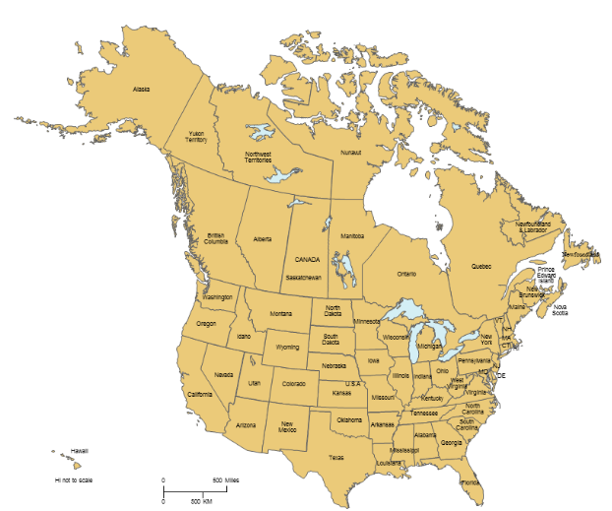
Where is this Available?
Shared Aggregate Policy
All states except California, Wisconsin and Illinois
Available now in Canada
Stand-Alone Policy
All states except California, Wisconsin and Illinois
Not Available in Canada within program

Slide 7
Sample Claims Scenario Sued for $100,000
Settled For: $1,000
Attorney’s Fees: $75,000
Total Cost: $76,000

Slide 8
Union Liability VS. Fidelity Bond Coverage
D&O Liability Insurance
IAFF Fidelity Bond
Covers: Locals who choose to purchase insurance
Applications: Wrongful Act, wrongful employment practice, personal injury
Price: dependent upon location/amount requested
Covers: Locals through IAFF at no cost
Applications: Faithful performance by employees, officers, elected officials
Price: $5,000 limit through IAFF, higher limits available

Slide 9
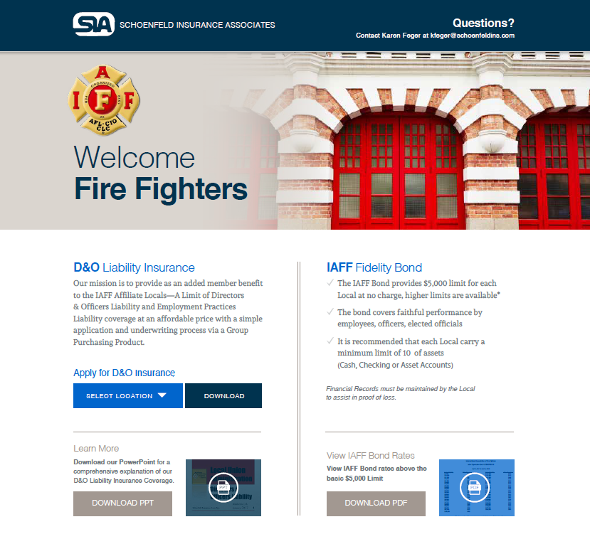
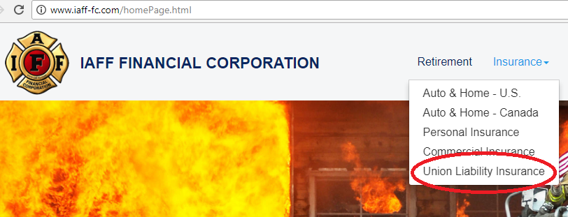
Learn More
Contact
Karen Feger
kfeger@schoenfeldins.com
Judy Morrison
jmorrison@schoenfeldins.com
Schoenfeld Insurance Assoc. Inc.
6225 Smith Ave
Baltimore, MD 21209
www.schoenfeldins.com/iaff
1-888-519-7575
www.schoenfeldins.com/iaff
www.iaff-fc.com

